Slide 1
University Events Management System
Group Members:
[Add Names Here]
[Add Roll Numbers Here]

Slide 2
Description
A PHP-based web application for university administrators to post, manage, and display upcoming events and announcements. Features include event creation, future event filtering, responsive UI, and secure database operations.

Slide 3
Requirements
PHP 7.0 or higher
MySQL 5.7 or higher
Web server (Apache/Nginx or PHP built-in)
PHP extensions: mysqli, filter, date
RAM: 512MB+, Disk: 100MB+

Slide 4
Tech Stack / Tools
PHP (Backend)
MySQL (Database)
HTML5, CSS3, Tailwind CSS (Frontend)
JavaScript (UI logic)
Apache/Nginx (Web server)

Slide 5
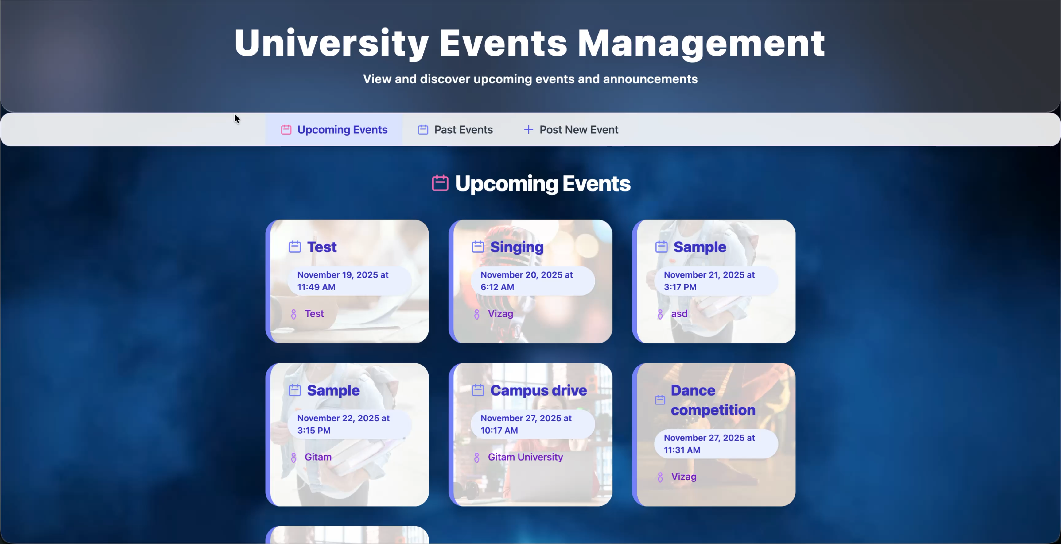

Slide 6
Backend
PHP scripts for form handling, validation, and database operations
Secure session management for admin
Prepared statements for SQL injection prevention

Slide 7
Database
MySQL database: university_events
Table: events (event_id, event_title, event_date, location, details, created_at)
See database.sql for schema and sample data

Slide 8
Flow of Site
Admin logs in
Admin posts new event (post_event.php)
Events are stored in MySQL
Users view upcoming events (upcoming_events.php)
Only future events are shown, sorted by date

Slide 9
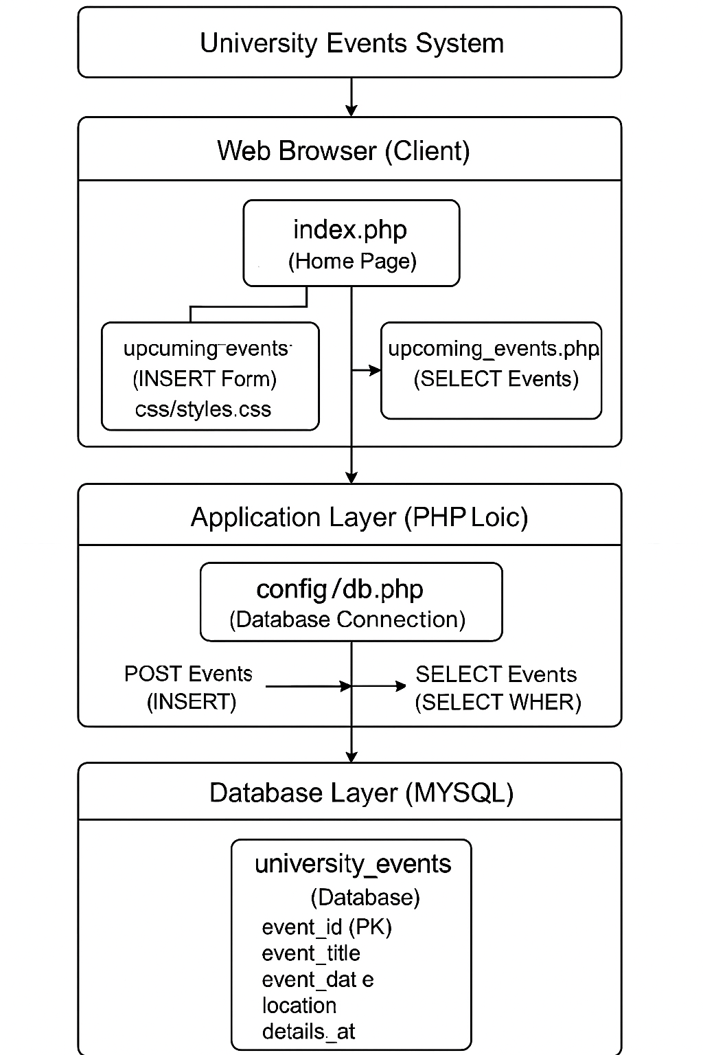
Architecture diagram

Slide 10
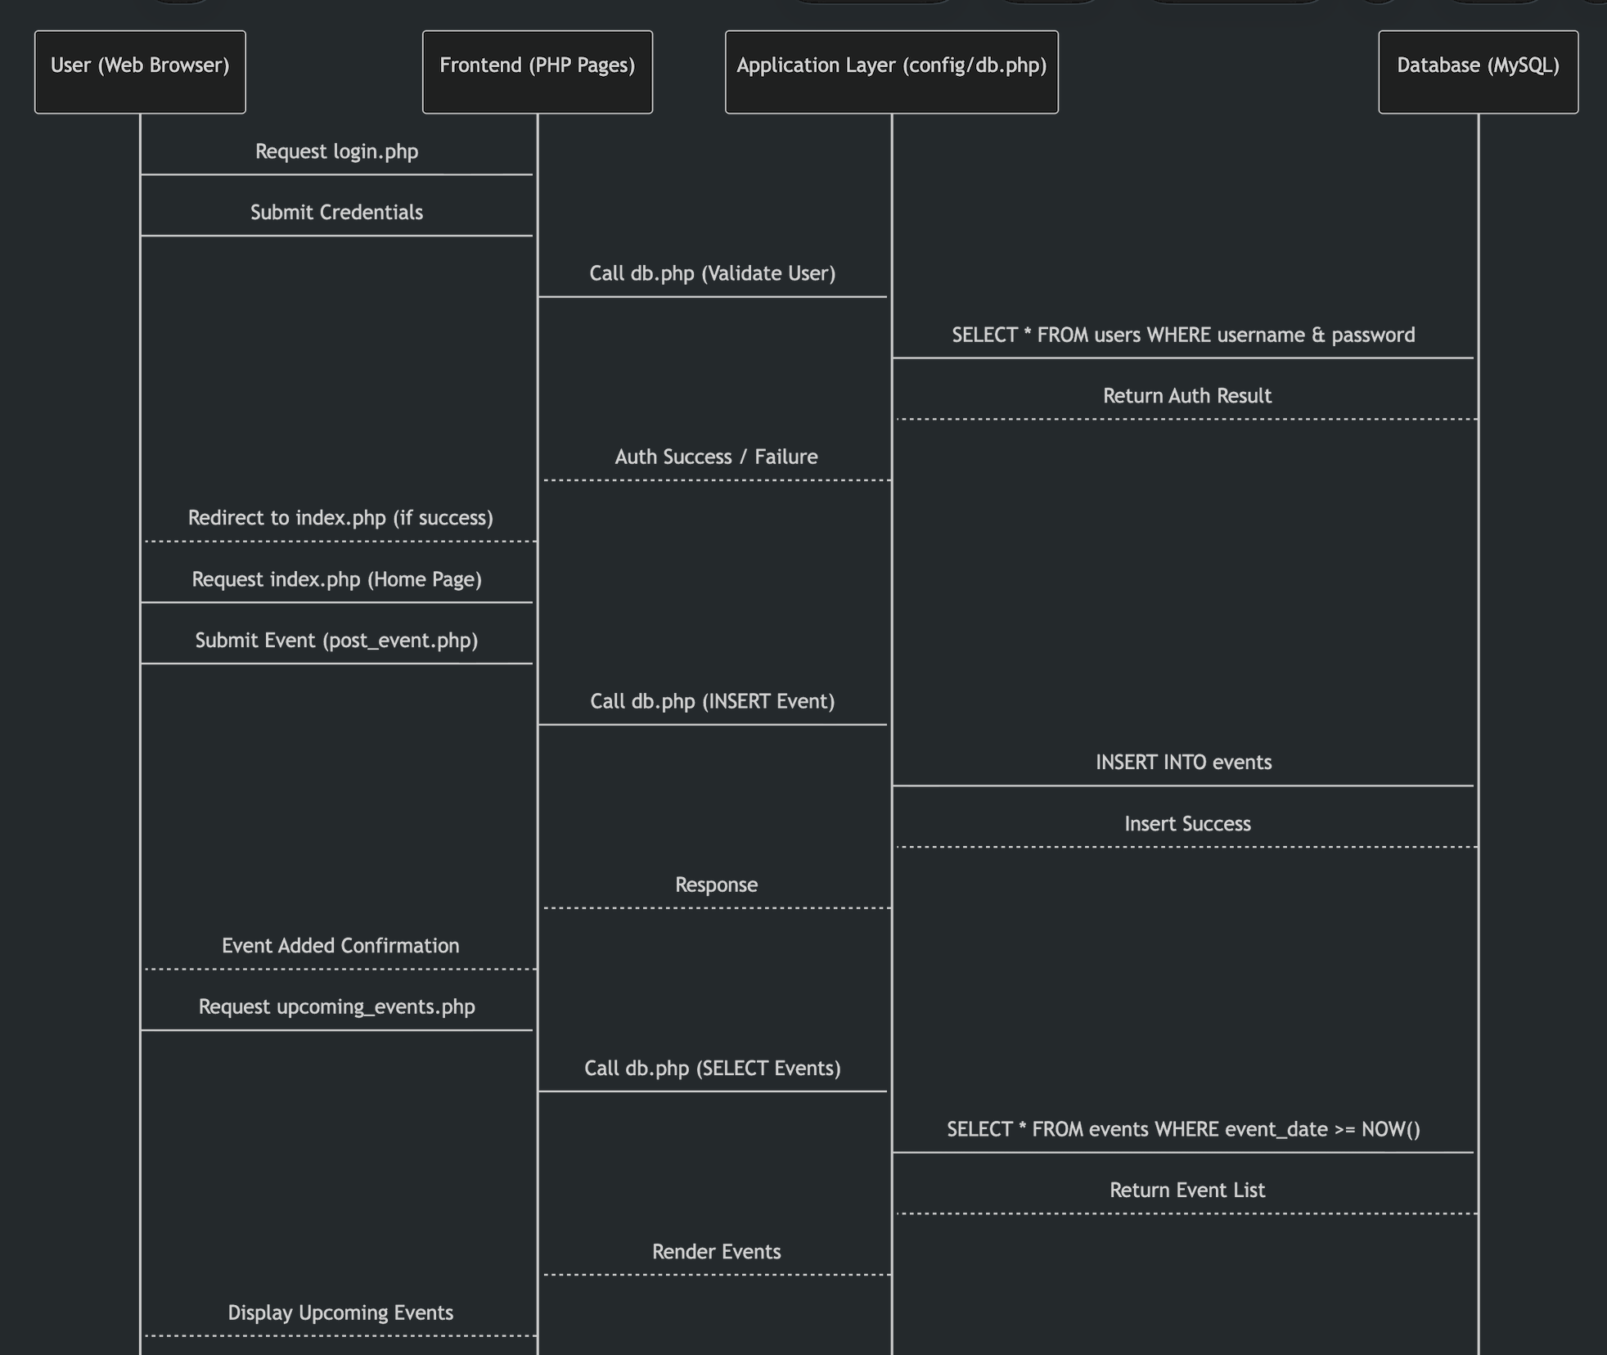
Sequence diagram

Slide 11
Challenges & Solutions
Responsive UI: Achieved with Tailwind CSS and custom CSS
Session security: Used PHP sessions for admin authentication
User feedback: Success/error messages with auto-hide

Slide 12

Thank You

